Slide 1
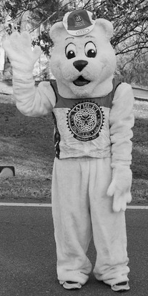
Polar Bear Metric Century
25th ANNUAL
100K(62 MILES) OR 50K (31 MILES) RIDE OPTIONS
SUPPORT:
SATURDAY JANUARY 13th 2024
SAG VEHICLES WILL CRUISE THE COURSE TO
SUPPORT ALL RIDERS AND TRANSPORT WEARY
RIDERS BACK TO THE STARTING POINT. ON-SITE/ON-ROAD SUPPORT PROVIDED THE CYCLE PATH
REGISTRATION AT 8:30AM
RIDE START AT 10:00AM
REST STOPS:
$35 PRE-REGISTRATION
(MINORS RIDE FREE WITH PARENT OR ADULT CHAPERONE)
$40 Jan 8th-12th
FOOD AND LIQUIDS WILL BE PROVIDED
SAFETY!:
ANSI OR SNELL APPROVED HELMETS ARE
REQUIRED FOR ALL RIDERS. FOR EVERYONE’S
SAFETY, RIDERS ON THE COURSE AFTER 3 PM WILL
BE OFFERED SAG TO THE FINISH.
Door Prizes!
START LOCATION
POST RIDE FOOD
AND BEER!!
JOIN US FOR SOUPS/SANDWICHES
Trane Technologies
800 Beaty St.
Davidson NC
REGISTER ONLINE @ RACEROSTER.COM
OR FROM THE LINK @
WWW.ROCKYRIVERROADCLUB.ORG

Slide 2
Polar Bear Metric Sponsors

